Slide 1

Chapter 7 Wireless and
Mobile Networks
Computer Networking: A Top-Down Approach 8th edition Jim Kurose, Keith Ross Pearson, 2020
Acknowledgement: Based on the textbook’s website: https://gaia.cs.umass.edu/kurose_ross/index.php
Notes:
Version History
8.0 (May 2020)
All slides reformatted for 16:9 aspect ratio
All slides updated to 8th edition material
Use of Calibri font, rather that Gill Sans MT
Add LOTS more animation throughout
lighter header font
4G/5G material completely updated; older 2/2.5/3G removed
8.2 (July 2023). Changes from 8.0:
minor updates and additional, including removing master/slave Bluetooth language
expansion, better graphics on wireless link characteristics
expanded, significant revisions of 4G/5G material (but not mobility)

Slide 2

Chapter 7 outline
Introduction
Wireless
Wireless links and network characteristics
WiFi: 802.11 wireless LANs
Cellular networks: 4G and 5G
Mobility
Mobility management: principles
Mobility management: practice
4G/5G networks
Mobile IP
Mobility: impact on higher-layer protocols

Slide 3
What is mobility?
spectrum of mobility, from the network perspective:
no mobility
high mobility
device moves
between networks, but
powers down
while moving
device moves within same AP in
one provider
network
device moves among APs in
one provider
network
device moves
among multiple
provider networks,
while maintaining
ongoing connections
We’re interested in these!

Slide 4

Mobility challenge:
content
provider
network
If a device moves from one network another:
How will the “network” know to forward packets to the new network?
datacenter
network
Verizon
public Internet
client moves from Verizon to AT&T
AT&T

Slide 5
Mobility approaches
let network (routers) handle it:
routers advertise well-known name, address (e.g., permanent 32-bit IP address), or number (e.g., cell #) of visiting mobile node via usual routing table exchange
Internet routing could do this already with no changes! Routing tables indicate where each mobile located via longest prefix match!

Slide 6
Mobility approaches
let network (routers) handle it:
routers advertise well-known name, address (e.g., permanent 32-bit IP address), or number (e.g., cell #) of visiting mobile node via usual routing table exchange
Internet routing could do this already with no changes! Routing tables indicate where each mobile located via longest prefix match!
not
scalable
to billions of
mobiles
let end-systems handle it: functionality at the “edge”
indirect routing: communication from correspondent to mobile goes through home network, then forwarded to remote mobile
direct routing: correspondent gets foreign address of mobile, send directly to mobile

Slide 7

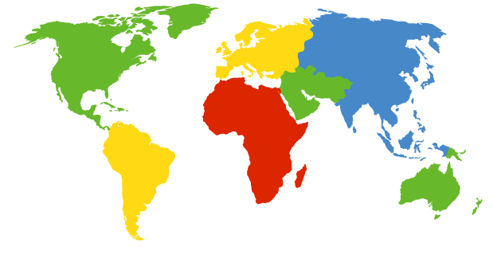

Contacting a mobile friend:
I wonder where Alice moved to?
Consider friend frequently changing locations, how do you find him/her?
search all phone books?
expect her to let you know where he/she is?
call his/her parents?
Facebook!
The importance of having a “home”:
a definitive source of information about you
a place where people can find out where you are

Slide 8
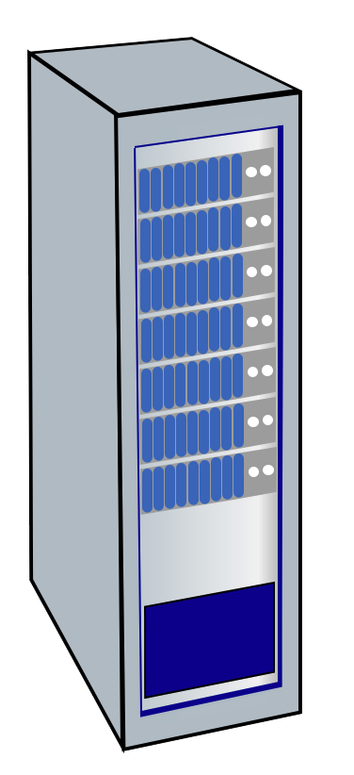
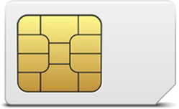
Home network, visited network: 4G/5G
home network:
(paid) service plan with cellular provider, e.g., Verizon, Orange
home network HSS stores identify & services info
Home
Subscriber
Server
home mobile
carrier network
P-GW
public Internet
and
inter-carrier IPX
…
…
in home network
visited network:
any network other than your home network
service agreement with other networks: to provide access to visiting mobile
P-GW
SIM card: global identify info including home network
visited mobile
carrier network
…
roaming in visited network

Slide 9







Home network, visited network: ISP/WiFi
ISP/WiFi: no notion of global “home”
credentials from ISP (e.g., username, password) stored on device or with user
ISPs may have national, international presence
different networks: different credentials
some exceptions (e.g., eduroam)
architectures exist (mobile IP) for 4G-like mobility, but not used
authentication
access
server
public Internet
…
…
attach
authentication
access
server
…
attach

Slide 10
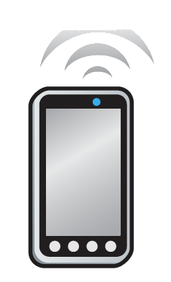

Home network, visited network: generic
Home Network
e.g.,: 128.119/16
Visited Network
e.g.,: 79.129/16
Permanent IP:
128.119.40.186
IMSI
78:4f:43:98:d9:27
Home
Subscriber
Server
NAT IP:
10.0.0.99
IMSI
78:4f:43:98:d9:27
Mobility manager
Mobility manager
Visited network gateway
Home network gateway
Home gateway
public or private Internet
Correspondent

Slide 11
Registration: home needs to know where you are!
Home Network
e.g.,: 128.119/16
Visited Network
e.g.,: 79.129/16
1
mobile associates with visited mobility manager
Permanent IP:
128.119.40.186
IMSI
78:4f:43:98:d9:27
Home
Subscriber
Server
NAT IP:
10.0.0.99
IMSI
78:4f:43:98:d9:27
2
Mobility manager
Visited network gateway
visited mobility manager registers mobile’s location with home HSS
Mobility manager
Home network gateway
Home gateway
public or private Internet
end result:
visited mobility manager knows about mobile
home HSS knows location of mobile

Slide 12
Mobility with indirect routing
Home Network
e.g.,: 128.119/16
Visited Network
e.g.,: 79.129/16
Permanent IP:
128.119.40.186
IMSI
78:4f:43:98:d9:27
Home
Subscriber
Server
NAT IP:
10.0.0.99
IMSI
78:4f:43:98:d9:27
3
Mobility manager
visited gateway router forwards to mobile
2
Mobility manager
4a
Visited network gateway
Home network gateway
Home gateway
home gateway receives datagram, forwards (tunnels) to remote gateway
public or private Internet
1
visited gateway router forwards reply to correspondent via home network (4a) or directly (4b)
4b
correspondent uses home address as datagram destination address
Correspondent

Slide 13
Mobility with indirect routing: comments
triangle routing:
inefficient when correspondent and mobile are in same network
mobile moves among visited networks: transparent to correspondent!
registers in new visited network
new visited network registers with home HSS
datagrams continue to be forwarded from home network to mobile in new network
on-going (e.g., TCP) connections between correspondent and mobile can be maintained!

Slide 14
Mobility with direct routing
Home Network
e.g.,: 128.119/16
Visited Network
e.g.,: 79.129/16
Permanent IP:
128.119.40.186
IMSI
78:4f:43:98:d9:27
Home
Subscriber
Server
NAT IP:
10.0.0.99
IMSI
78:4f:43:98:d9:27
4
Mobility manager
visited gateway router forwards to mobile
Mobility manager
Visited network gateway
Home gateway
2
public or private Internet
3
correspondent contacts home HSS, gets mobile’s visited network
1
Correspondent addresses datagram to visited network address
Correspondent

Slide 15
Mobility with direct routing: comments
overcomes triangle routing inefficiencies
non-transparent to correspondent: correspondent must get care-of-address from home agent
what if mobile changes visited network?
can be handled, but with additional complexity

Slide 16
Chapter 7 outline
Introduction
Wireless
Wireless links and network characteristics
WiFi: 802.11 wireless LANs
Cellular networks: 4G and 5G
Mobility
Mobility management: principles
Mobility management: practice
4G/5G networks
Mobile IP
Mobility: impact on higher-layer protocols

Slide 17
Mobility in 4G networks: major mobility tasks
1
base station association:
covered earlier
mobile provides IMSI – identifying itself, home network
Mobility manager
Home
Subscriber
Server
2
1
MME
Home
network
3
base station
P-GW
S-GW
4
2
control-plane configuration:
MME, home HSS establish control-plane state - mobile is in visited network
Internet
P-GW
Visited network
Streaming server
3
data-plane configuration:
MME configures forwarding tunnels for mobile
visited, home network establish tunnels from home P-GW to mobile
4
mobile handover:
mobile device changes its point of attachment to visited network

Slide 18
Configuring LTE control-plane elements
Mobility manager
Home
Subscriber
Server
2
MME
Home
network
base station
P-GW
P-GW
S-GW
Visited network
Mobile communicates with local MME via BS control-plane channel
MME uses mobile’s IMSI info to contact mobile’s home HSS
retrieve authentication, encryption, network service information
home HHS knows mobile now resident in visited network
BS, mobile select parameters for BS-mobile data-plane radio channel

Slide 19
Configuring data-plane tunnels for mobile
Mobility manager
S-GW to BS tunnel: when mobile changes base stations, simply change endpoint IP address of tunnel
S-GW to home P-GW tunnel: implementation of indirect routing
Home
Subscriber
Server
MME
Home
network
base station
P-GW
S-GW
Internet
P-GW
Visited network
Streaming server
tunneling via GTP (GPRS tunneling protocol): mobile’s datagram to streaming server encapsulated using GTP inside UDP, inside datagram

Slide 20
Handover between BSs in same cellular network
data path before handover
source BS
1
current (source) BS selects target BS, sends Handover Request message to target BS
3
S-GW
1
4
2
P-GW
2
target BS pre-allocates radio time slots, responds with HR ACK with info for mobile
data path after
handover
MME
target BS
3
source BS informs mobile of new BS
mobile can now send via new BS - handover looks complete to mobile
4
source BS stops sending datagrams to mobile, instead forwards to new BS (who forwards to mobile over radio channel)

Slide 21
Handover between BSs in same cellular network
source BS
3
S-GW
1
4
5
target BS informs MME that it is new BS for mobile
MME instructs S-GW to change tunnel endpoint to be (new) target BS
2
6
P-GW
5
7
5
MME
target BS
6
target BS ACKs back to source BS: handover complete, source BS can release resources
7
mobile’s datagrams now flow through new tunnel from target BS to S-GW

Slide 22
Mobile IP
mobile IP architecture standardized ~20 years ago [RFC 5944]
long before ubiquitous smartphones, 4G support for Internet protocols
did not see wide deployment/use
perhaps WiFi for Internet, and 2G/3G phones for voice were “good enough” at the time
mobile IP architecture:
indirect routing to node (via home network) using tunnels
mobile IP home agent: combined roles of 4G HSS and home P-GW
mobile IP foreign agent: combined roles of 4G MME and S-GW
protocols for agent discovery in visited network, registration of visited location in home network via ICMP extensions

Slide 23
Wireless, mobility: impact on higher layer protocols
logically, impact should be minimal …
best effort service model remains unchanged
TCP and UDP can (and do) run over wireless, mobile
… but performance-wise:
packet loss/delay due to bit-errors (discarded packets, delays for link-layer retransmissions), and handover loss
TCP interprets loss as congestion, will decrease congestion window un-necessarily
delay impairments for real-time traffic
bandwidth a scare resource for wireless links

Slide 24
Chapter 7 summary
Wireless
Wireless Links and network characteristics
WiFi: 802.11 wireless LANs
Cellular networks: 4G and 5G
Mobility
Mobility management: principles
Mobility management: practice
4G/5G networks
Mobile IP
Mobility: impact on higher-layer protocols

